Slide 1


Smarter Data Analysis Starts with Python
Unlock the power of data-driven insights and transform your career with Python programming for analytics and machine learning

Slide 2
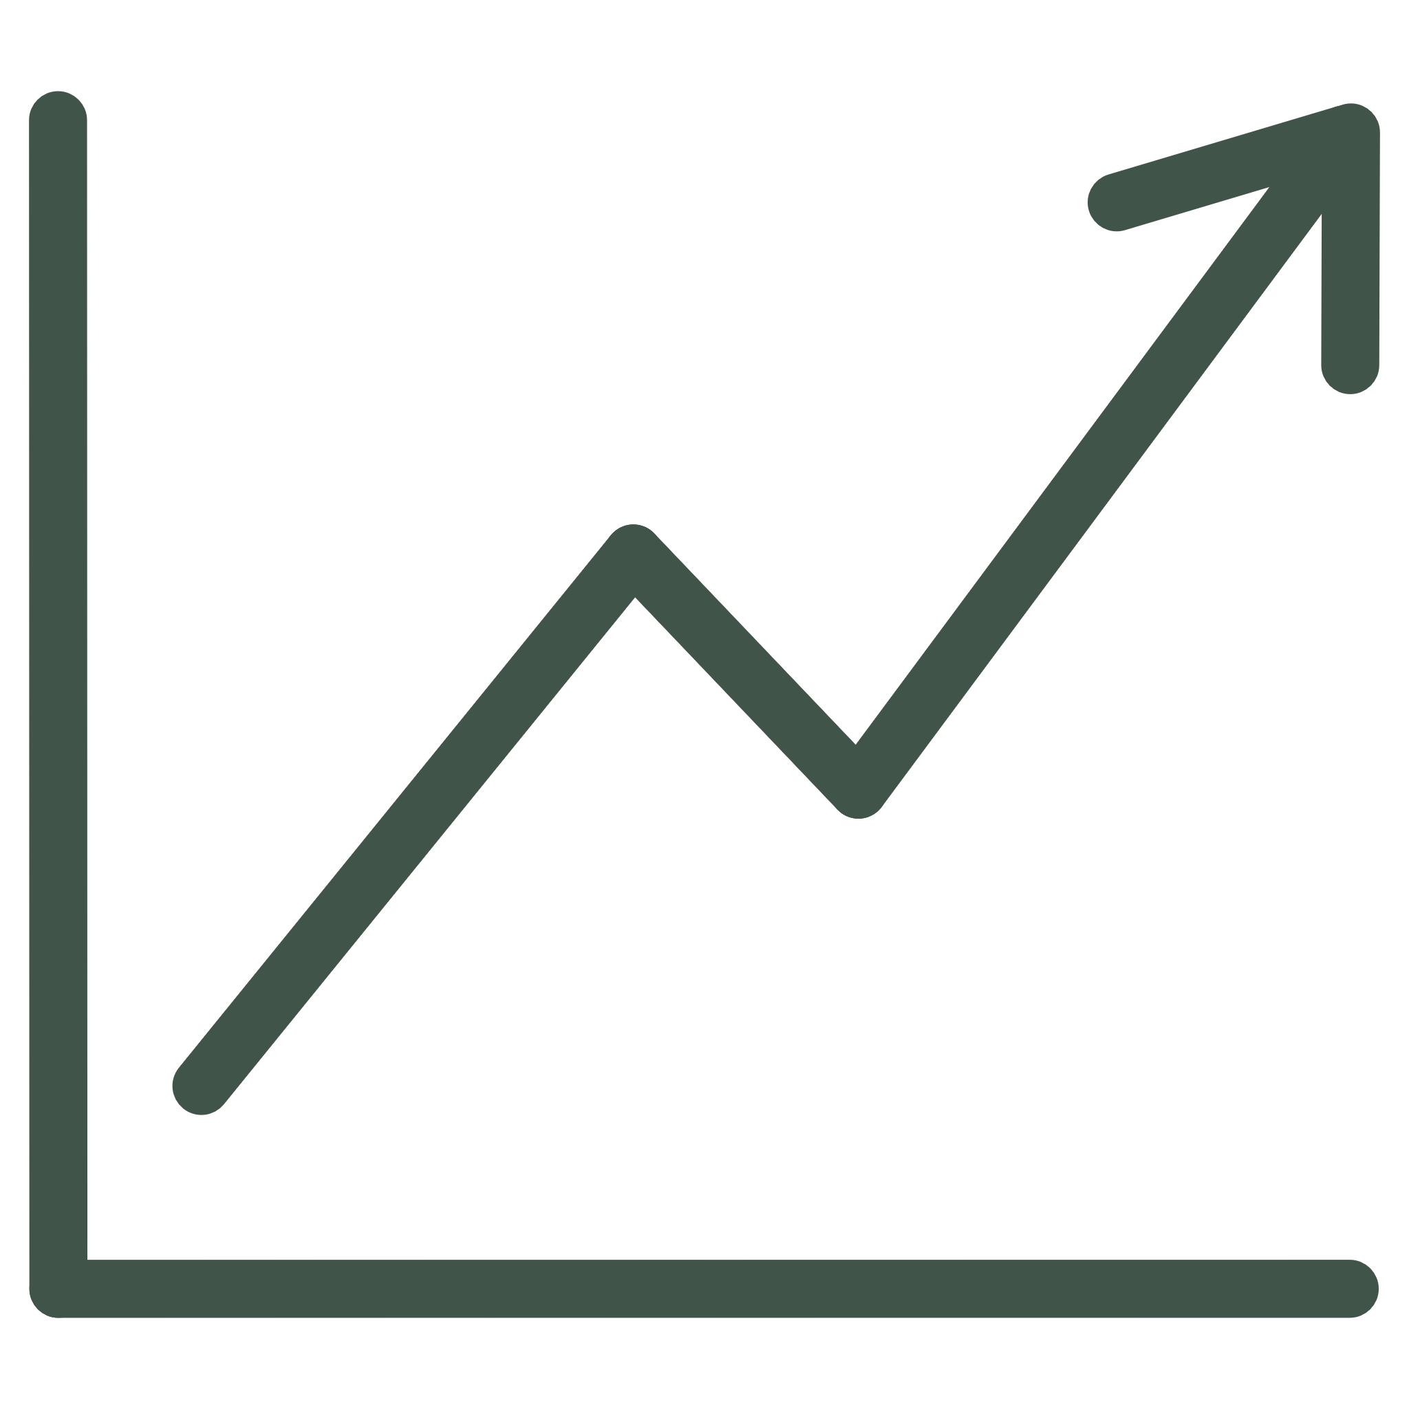
DATA ANALYTICS
Why Python Dominates Data Science
Python has become the leading programming language for data analysis, machine learning, and artificial intelligence. Its versatility, extensive libraries, and ease of learning make it indispensable for modern data professionals.
83%
47%
Market Share
Salary Increase
Data scientists using Python globally
Average boost with Python skills
From financial modelling to predictive analytics, Python empowers analysts to extract meaningful insights from complex datasets efficiently.

Slide 3





Essential Python Libraries for Data Analysis
Pandas
Data manipulation and analysis with powerful DataFrames for structured data processing
NumPy
Numerical computing with multi-dimensional arrays and mathematical functions
Matplotlib
Create stunning visualisations and interactive plots for data storytelling
Scikit-learn
Machine learning algorithms for predictive modelling and pattern recognition

Slide 4
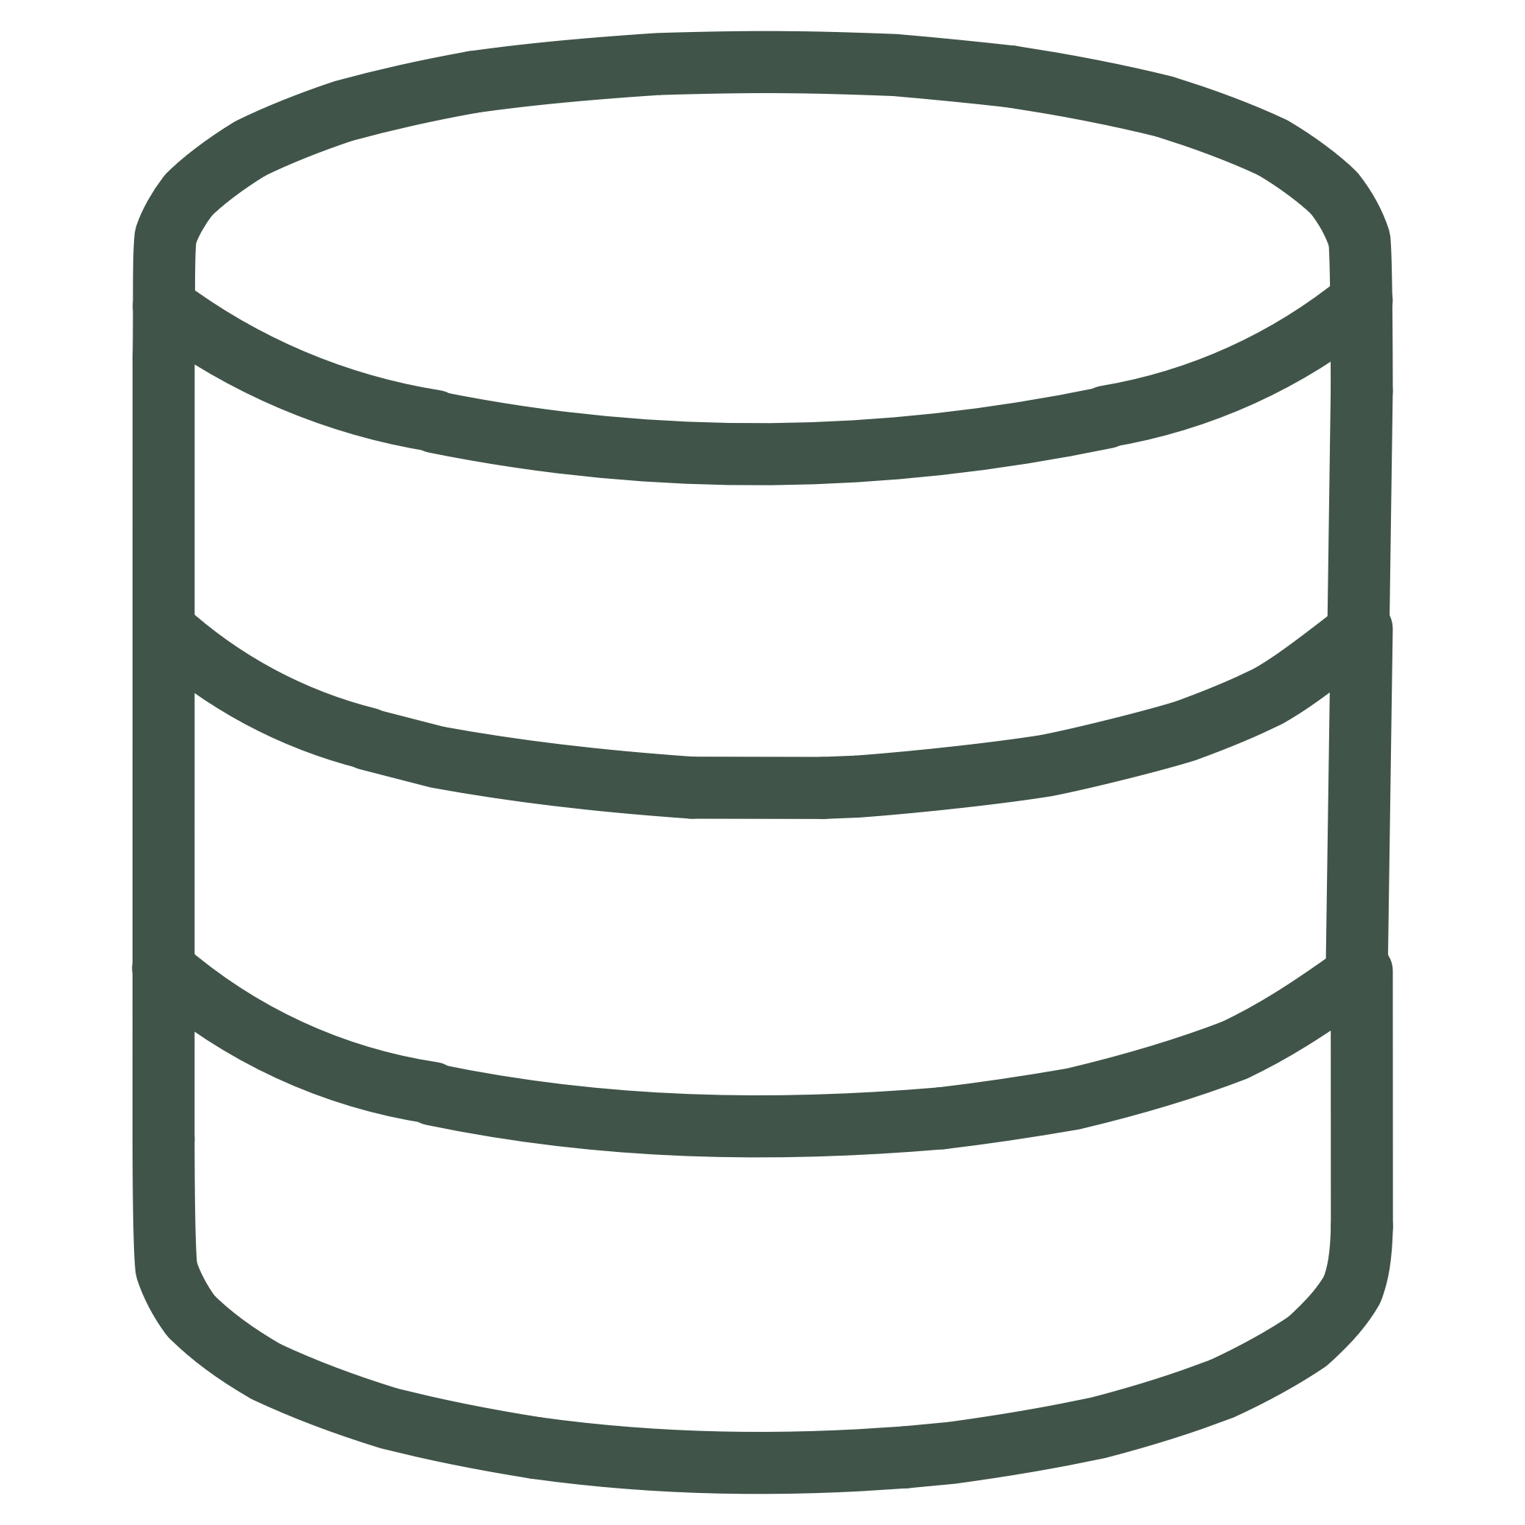



LEARNING PATH
Your Journey to Python Data Mastery
Data Wrangling
Foundation Building
Learn data cleaning, transformation, and preparation techniques using Pandas and NumPy
Master Python syntax, data structures, and programming fundamentals through hands-on practice
Machine Learning
Visualisation Skills
Build predictive models and apply statistical analysis for real-world business problems
Create compelling data visualisations with Matplotlib, Seaborn, and Plotly libraries

Slide 5

Real-World Applications of Python in Data Analytics
Financial Analytics
Risk assessment, portfolio optimisation, and algorithmic trading strategies
Healthcare Insights
Patient data analysis, disease prediction, and medical research acceleration
Marketing Intelligence
Customer segmentation, campaign performance, and predictive customer behaviour
Business Operations
Supply chain optimisation, demand forecasting, and operational efficiency

Slide 6
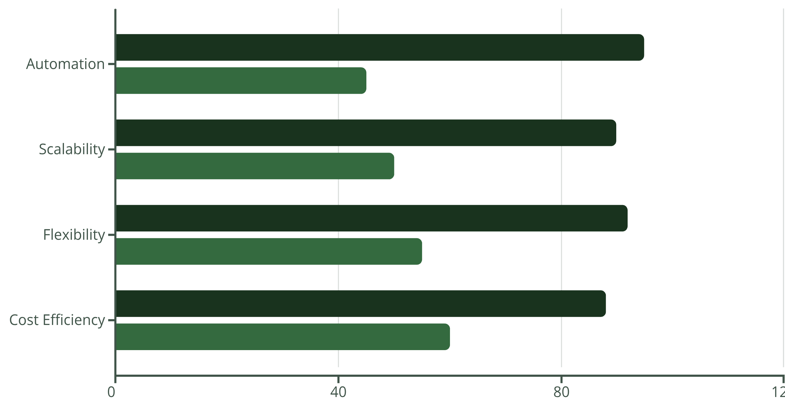
Python vs Traditional Tools: The Competitive Edge
Python
Traditional Tools
Python outperforms traditional analytics tools in automation, scalability, and flexibility, whilst offering superior cost efficiency for businesses of all sizes.

Slide 7

CAREER GROWTH
High-Demand Career Opportunities
Data Analyst
Data Scientist
ML Engineer
Entry-level: £35,000–£50,000
Mid-level: £50,000–£75,000
Mid-level: £60,000–£85,000
Senior: £60,000–£85,000
Senior: £80,000–£120,000
Senior: £90,000–£140,000

Slide 8


Build Your Python Data Analytics Portfolio
Essential Portfolio Projects
01
Exploratory Data Analysis
Analyse real datasets to uncover patterns and trends
02
Predictive Modelling
Build machine learning models for forecasting
03
Data Visualisation Dashboard
Create interactive dashboards with Plotly or Dash
04
Web Scraping Project
Extract and analyse data from websites
Pro tip: Showcase your projects on GitHub with clear documentation and visualisations to stand out to potential employers.

Slide 9





Industry Certifications That Boost Your Career
Python Institute PCAP
Certified Associate in Python Programming validates fundamental Python skills
Microsoft Data Analyst
Power BI and Python integration for enterprise-level analytics
Google Data Analytics
Professional certificate covering Python, SQL, and visualisation tools
IBM Data Science
Professional certificate in machine learning and Python programming

Slide 10

Start Your Data Analytics Journey Today
Why Choose Professional Python Training?
Industry-relevant curriculum
Learn the latest tools and techniques used by leading companies
Hands-on practical experience
Work on real-world projects that build your portfolio
Expert mentorship
Guidance from experienced data professionals throughout your journey
Career support services
Job placement assistance and interview preparation included
Transform your career with Python data analytics skills and unlock unlimited opportunities in the fastest-growing field.

Slide 11
THANK YOU
Thank you for joining us today. We hope you found this presentation valuable. We wish you all the best.
For more information, or visit our website:- Attitude Academy

